Slide 1
Development of master curricula for natural disasters risk management in Western Balkan countries
Introduction of the University as well as the role in NatRisk
Priv.-Doz. DI Dr. Michael Tritthart
University of Natural Resources and Life Sciences BOKU, Vienna
Kick-off meeting / 16th December 2016
Project number: 573806-EPP-1-2016-1-RS-EPPKA2-CBHE-JP
"This project has been funded with support from the European Commission. This publication reflects the views only of the author, and the Commission cannot be held responsible for any use which may be made of the information contained therein"

Slide 2
Mission Statement
Development of master curricula for natural disasters risk management in Western Balkan countries
BOKU – University of Natural Resources and Life Sciences, Vienna
„It is BOKU´s core competence to research and impart knowledge of sustainably using natural resources and thus providing options to safeguard natural resources. Thereby the „University of Life“ offers answers to issues that affect the general public and that are highly relevant for each and everyone of us.“

Slide 3
Facts & Figures
Development of master curricula for natural disasters risk management in Western Balkan countries
Students
… from Austria | 10.342
… from the EU | 1.941
… from third countries | 628
Overall | 12.911
Staff
Scientific staff | 1.069
Non-scientific staff | 559
Overall staff | 1.628
Study programs
Bachelor | 8
Master | 26
PhD | 4
Overall | 38

Slide 4
Organisation
Development of master curricula for natural disasters risk management in Western Balkan countries
University(BOKU)
15 Departments (Department of Water, Atmosphere and Environment – WAU)
66 Institutes (Institute of Water Management, Hydrology and Hydraulic Engineering – IWHW)

Slide 5
Study programs
Development of master curricula for natural disasters risk management in Western Balkan countries
Programs with WAU responsibility
Bachelor Level
Environmental Engineering (Kulturtechnik und Wasserwirtschaft) | 48%
Master Level
Environmental Engineering (Kulturtechnik und Wasserwirtschaft) | 44%
Water Management and Environmental Engineering (WMEE) | 57%
Applied Limnology (MAL) | 100%
Natural Resources Management and Ecological Engineering (NARMEE) | 38%
Environmental Sciences – Soil, Water and Biodiversity (ENVEURO) | 35%
Alpine Natural Dangers / Watershed Regulation | 11%

Slide 6
Research fields
Development of master curricula for natural disasters risk management in Western Balkan countries
Water management Relation between water and environment, sustainable water use
Hydrology Hydrological processes as a foundation for all water related planning and constructions; focus on discharge
Hydraulic engineering Selection of technical measures to support economic and social interests, considering the ecological functionality

Slide 7
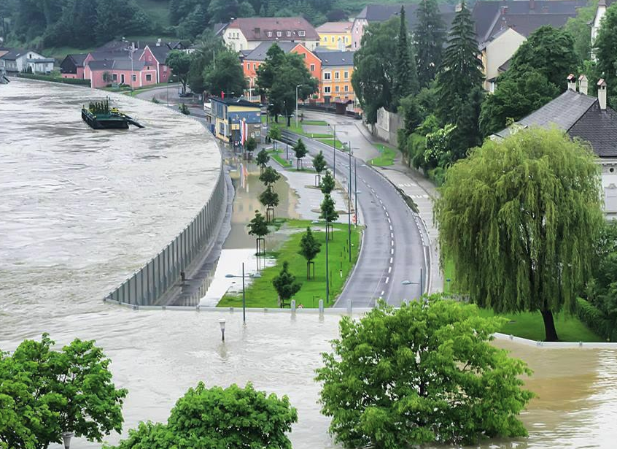
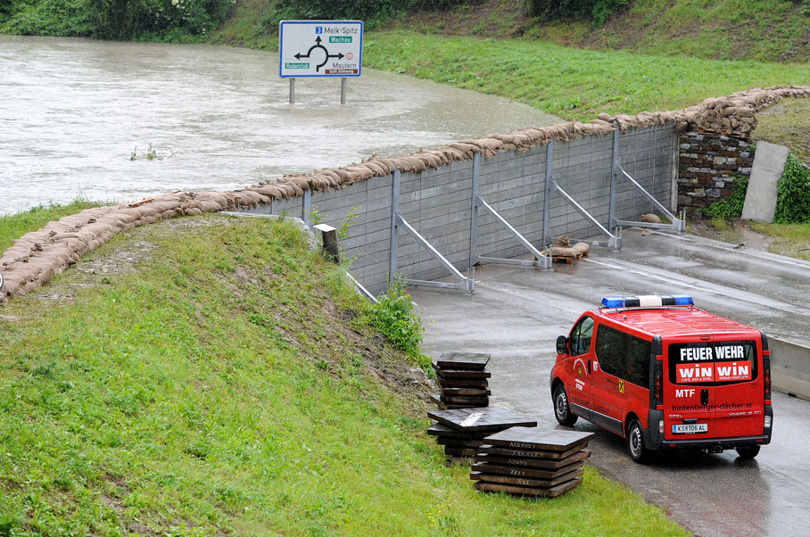
Related projects
Development of master curricula for natural disasters risk management in Western Balkan countries
Floods documentation June 2013
Analysis of precipitation and discharge
Documentation of inundated areas
Analysis of sediment budget and morphology
Effects of implemented protective measures
(BMLFUW, 2015)

Slide 8
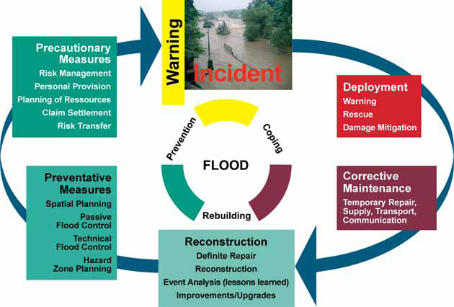
Related projects
Development of master curricula for natural disasters risk management in Western Balkan countries
Flood risk I and II
Analysis of natural hazard documentations
Recommendations for future improvements („lessons learned“)
Development of effective implementation strategies for integrated flood management
(BMLFUW, 2004)

Slide 9
Related projects
Development of master curricula for natural disasters risk management in Western Balkan countries
PRO_Floodplain
Investigation of the effects of non-structural flood protections measures (dyke displacements, reconnection of floodplains,…)
Integrated evaluation of existing and potential floodplains in terms of hydrology, hydraulics, ecology and sociology
Summarising presentation within the Floodplain Evaluation Matrix (FEM)
(BMLFUW, 2014)

Slide 10
Contact information
Development of master curricula for natural disasters risk management in Western Balkan countries
University of Natural Resources and Life Sciences Vienna (BOKU)
Department of Water, Atmosphere and Environment (WAU)
Institute of Water Management, Hydrology and Hydraulic Engineering (IWHW)
Find more about IWHW in
http://www.wau.boku.ac.at/en/iwhw/
Michael Tritthart
Priv.-Doz. Dipl.-Ing. Dr.techn.
E-mail: michael.tritthart@boku.ac.at
Kurt Glock
Dipl.-Ing.
E-mail: kurt.glock@boku.ac.at

